Slide 1

Confirmed Influenza Cases in Australia 2008 - 2017
Exploratory Data Analysis

Slide 2

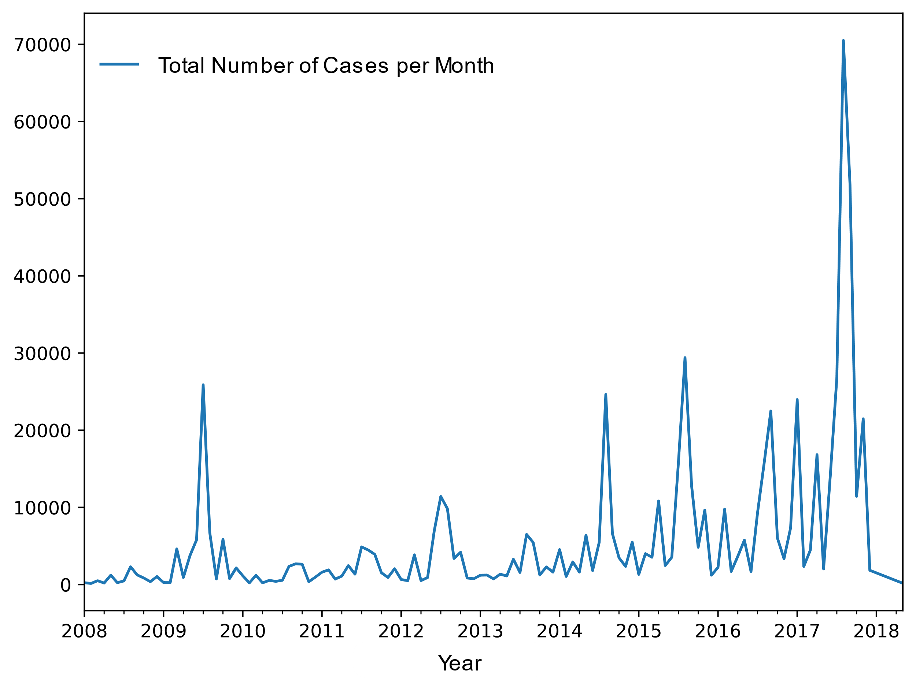
Confirmed Influenza Cases in Australia
2008-2017
The Data Source:
Australian Influenza Surveillance Report and Activity Updates:
The Australian Influenza Surveillance Report and Activity Updates are compiled from a number of data sources, which are used to monitor influenza activity and severity in the community. These data sources include laboratory-confirmed notifications to NNDSS; influenza associated hospitalisations; sentinel influenza-like illness (ILI) reporting from general practitioners; ILI-related community level surveys; and sentinel laboratory testing results.
Influenza (laboratory confirmed) Public dataset

Slide 3
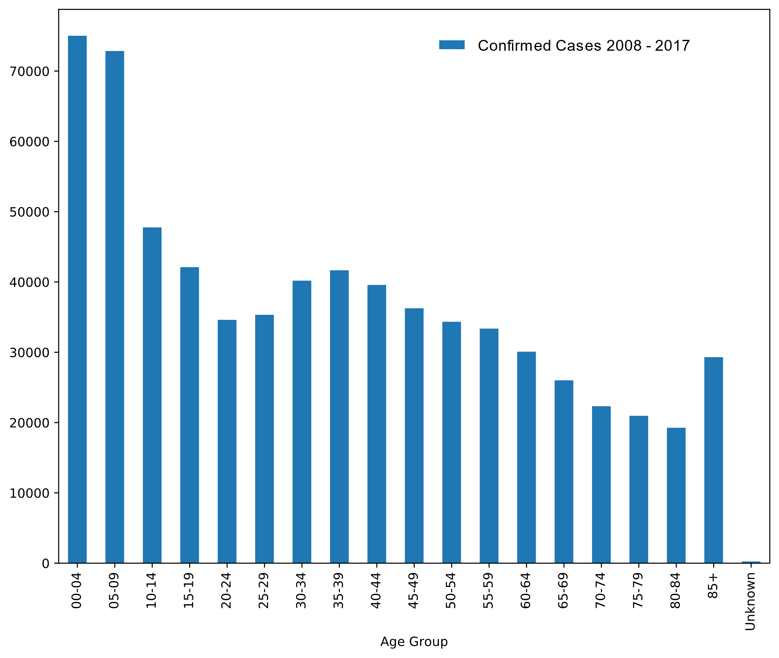
Confirmed Influenza Cases in Australia
2008-2017
This Graph represents all confirmed cases during the
Period 2008-2017.
The graph represents confirmed cases by Age Group.
(Bins = 5 years intervals)

